Slide 1
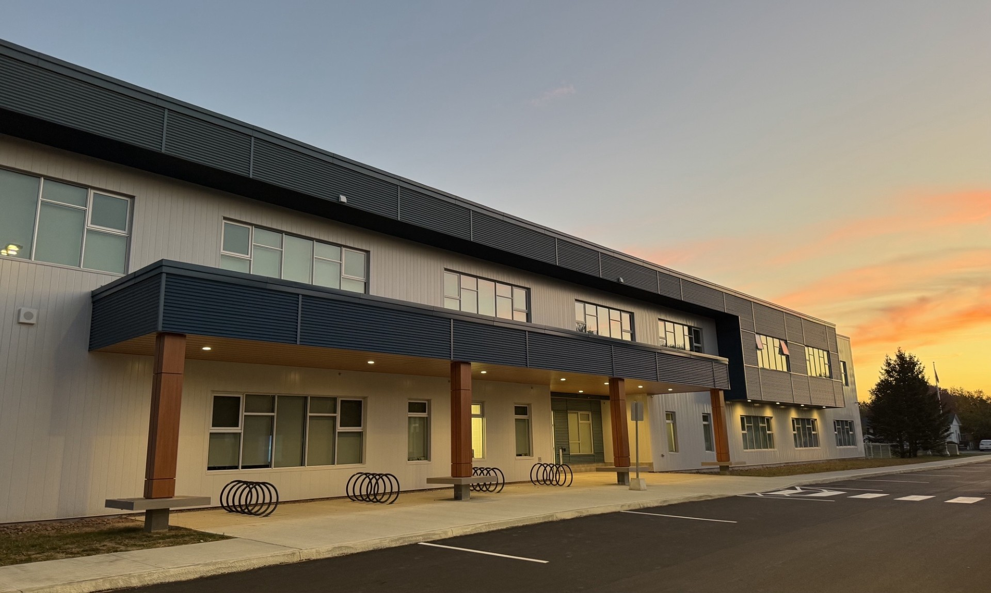

Welcome to
Kindergarten
at...
Sunset Acres Elementary School

Slide 2


We love to learn and have fun!
There is so much going on throughout the year!
Harvest Jazz and Blues – Blues in the Schools​
Orange Shirt Day​
Autism Awareness
Pink Shirt Day
School Spirit theme days
Safe Schools Week​
Terry Fox Walk​
Remembrance Day​
Sunny Slips
Cool Cat Awards
Concerts​ and Presentations
Clubs and Activities​
…and many more!
.

Slide 3
Need to Know
Policy 704 - Health Concerns:
Inform your child’s teacher or the school of any specific health concerns. If your child requires medication to be administered, forms must be completed. These forms are available at the office. We cannot administer any medication without this form.
Parking and Drop Off Zone:
You may drop your child off in the front of the school in the designated area (kiss and drop style). Please, no parking in the drop off area. Families are not permitted on the playground (for safety reasons).
Bell rings for school to start at 8:00 am.
If your child arrives late, they must be buzzed in at the front doors of the school. Once students have settled in September, we ask that your child comes in alone and goes to their class.

Slide 4
Need to Know
We are a *NUT FREE* school as we have students and staff who have life-threatening allergies. This includes Nutella.
Please send any utensils that your child may need as we do not provide them.
Safe Arrival Program (Report an Absence):
We offer a safe arrival program. If parents have not called the school to notify us of the absence, an automated call will be placed at 9:00 am to inform parents.
We request that parents contact the school in the morning if
your child is going to be absent.

Slide 5

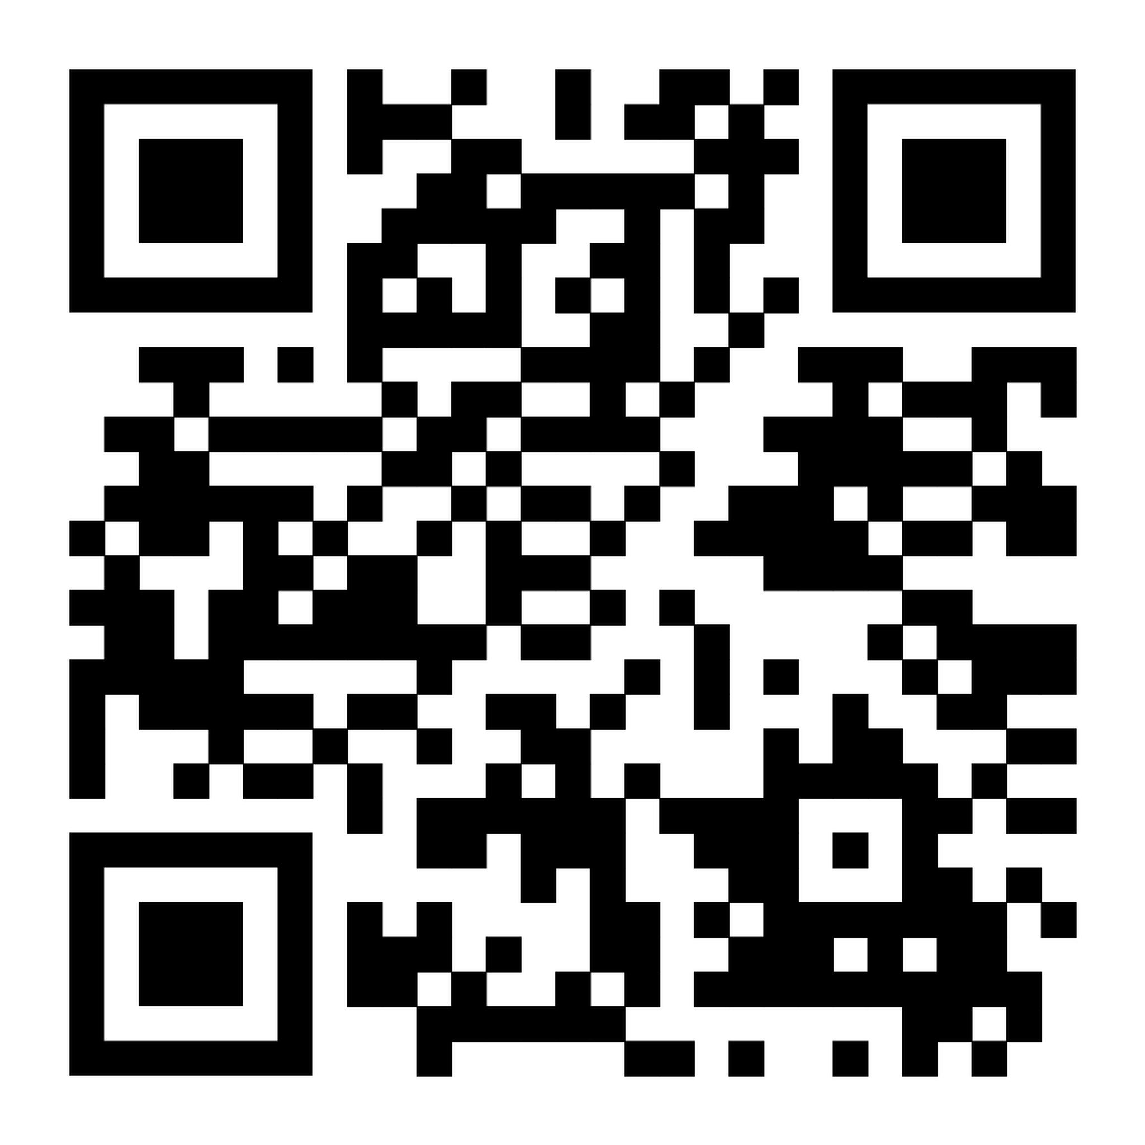
Need to Know – continued.
Student Fee / Supplies:
$60.00 student fee (due as soon as possible).
This student fee helps purchase school supplies
for your child throughout the year.
Pay online at School Cash Online:
https://anglophonewest.schoolcashonline.com/
We also ask that you supply:
backpack
lunchbox
box of large Ziploc bags
box of tissues
luggage tag (attached to backpack) with after school information

Slide 6

Student Safety
Your child's safety is our top priority. We have approximately 400 students who sometimes move independently through the halls. In order to keep them safe from strangers, we ask that you do not come into the building without an appointment. If you do not have an appointment, but need access to your child, please ring the front doorbell, and let our office staff know and they will call your child down to the office. Thank you for understanding!!

Slide 7
Indoor Footwear/Outdoor Footwear:
Pair of indoor non marking sole sneakers for the classroom and Physical Education
Easy for your child to put on and take off independently.
If they are not yet tying laces, slip-on or velcro closing sneakers are required.
Please label all belongings.

Slide 8
Extra Clothing and Labeling
Extra full change of clothes (socks, underwear, shirt, pants) kept inside a Ziploc bag. This will stay in your child’s bookbag all year.
Check frequently in case they need a new change of clothes (stains, wet, bathroom accidents etc.).
Clothing that is easy for them to put on independently.
PLEASE REMEMBER TO LABEL ALL OF YOUR CHILD’S PERSONAL BELONGINGS. 😊

Slide 9
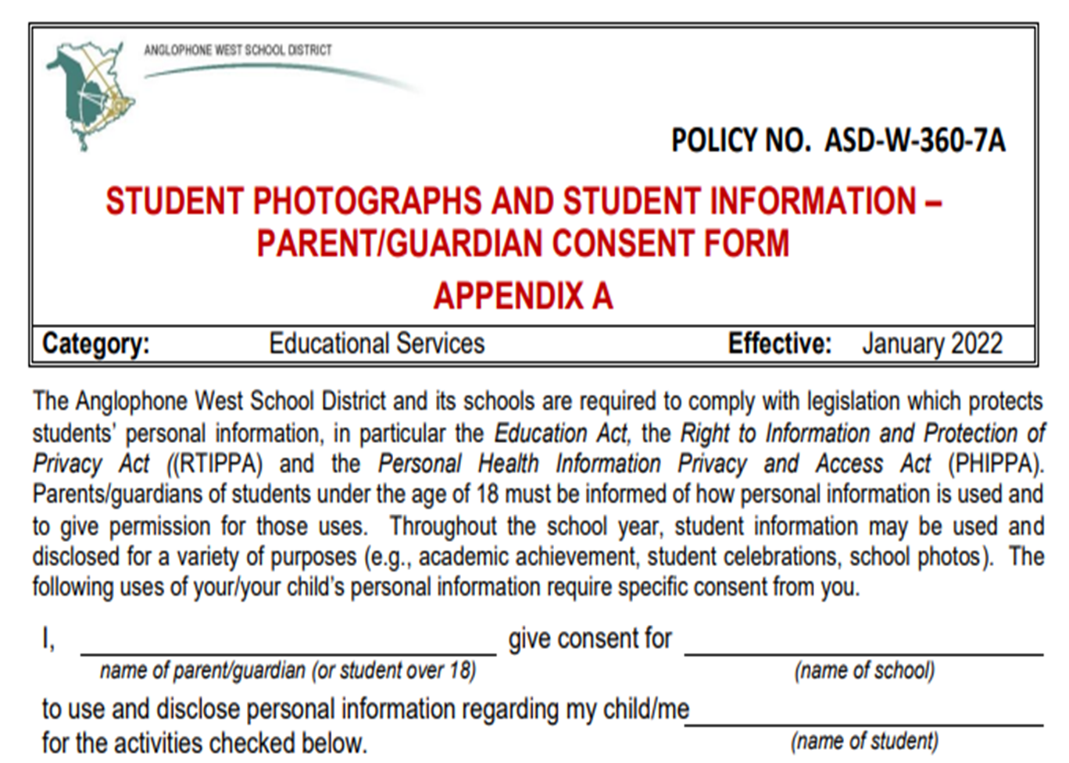

Slide 10
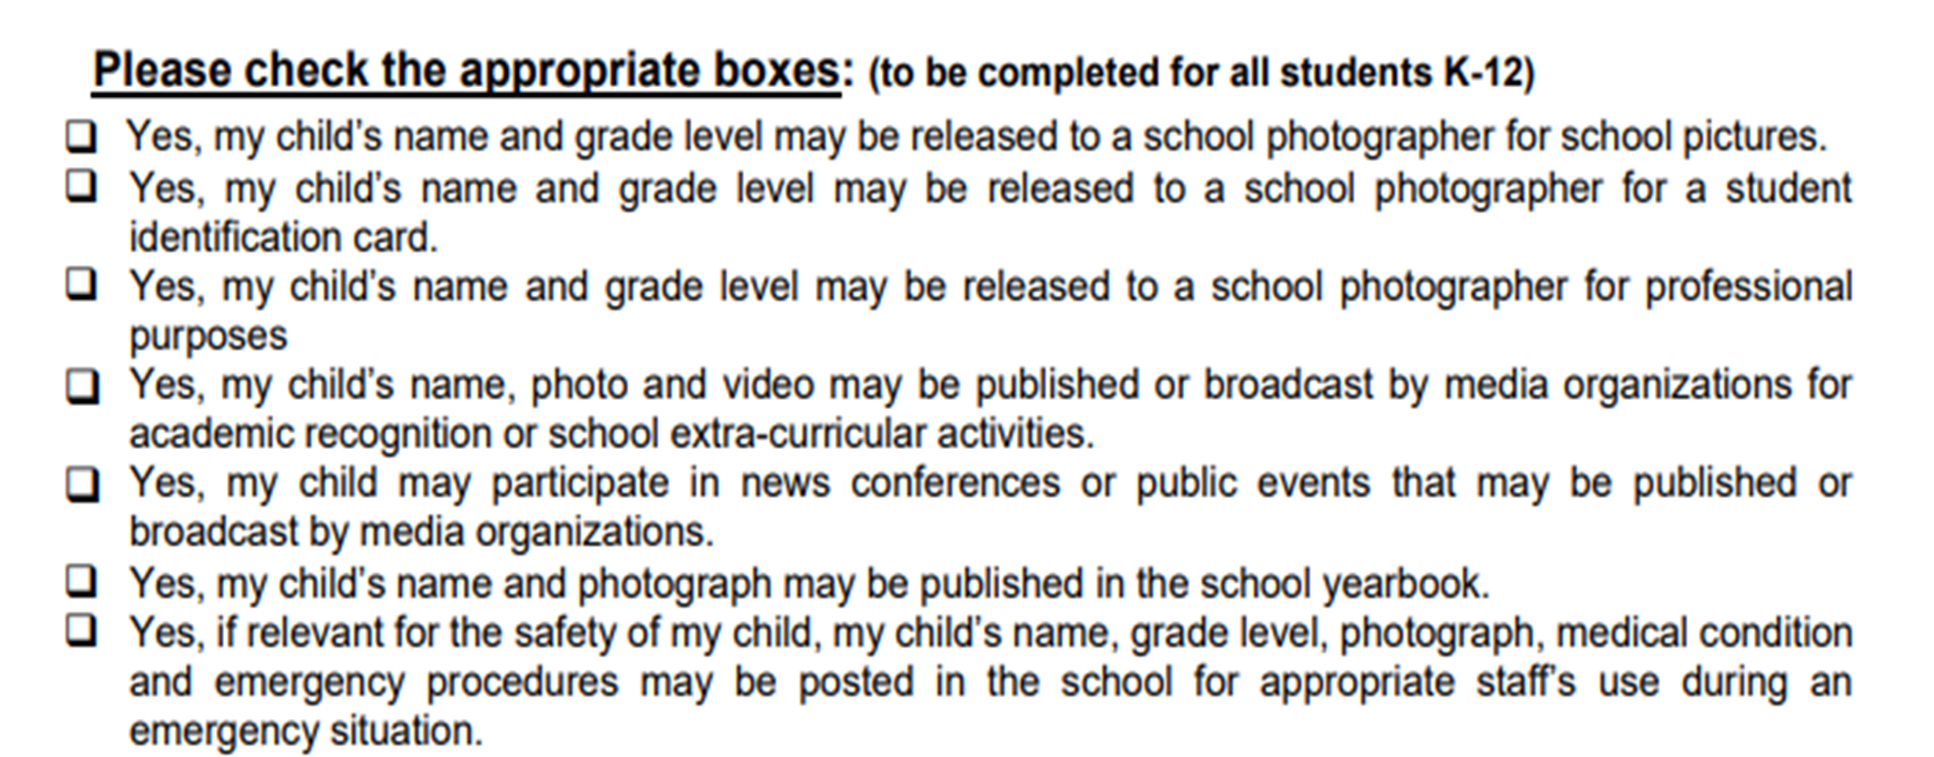

Slide 11
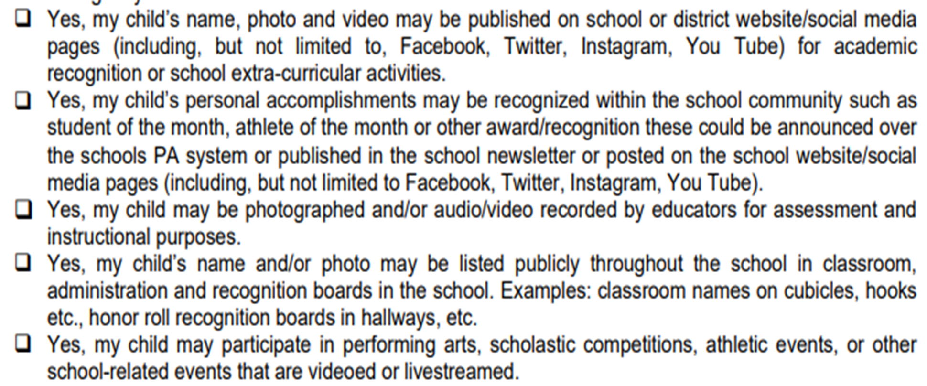

Slide 12
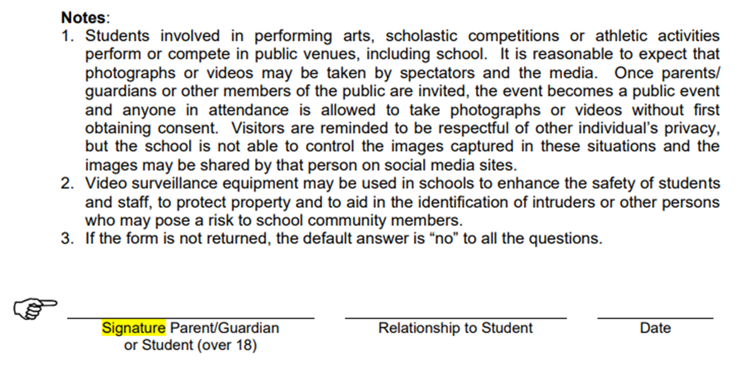

Slide 13
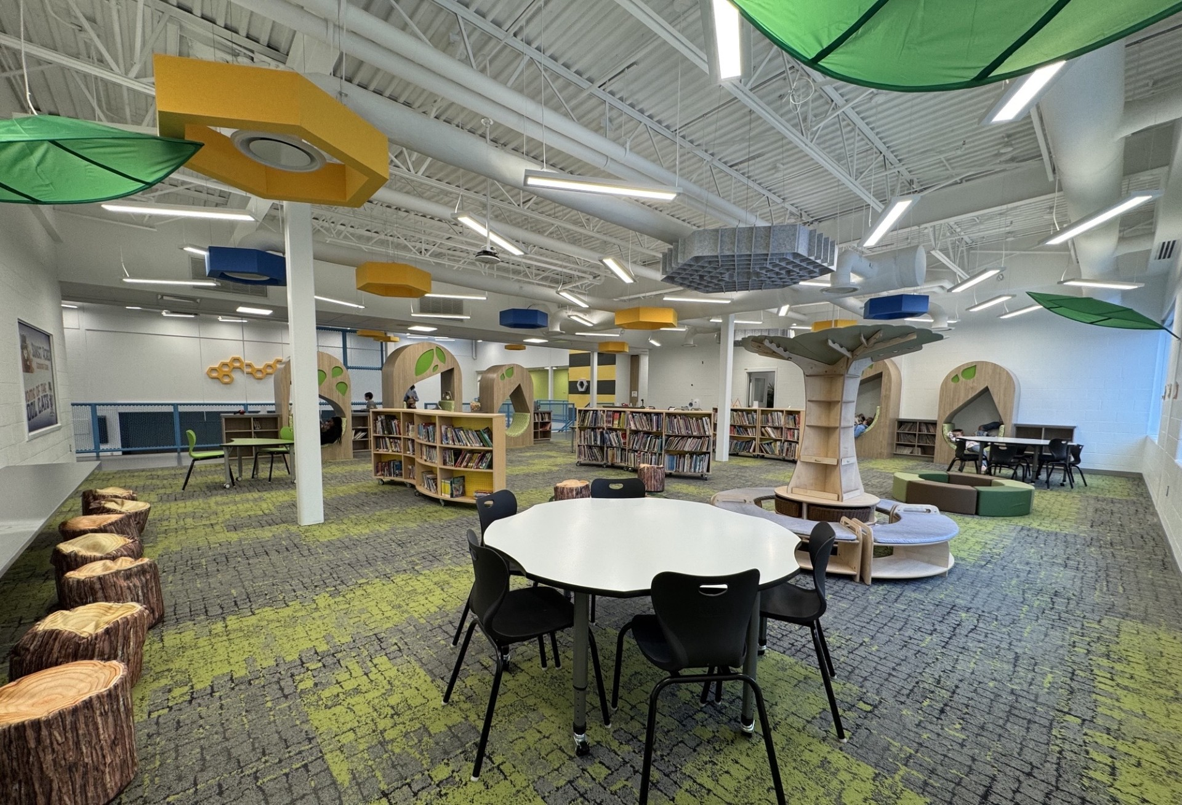
A Peek
Inside…

Slide 14
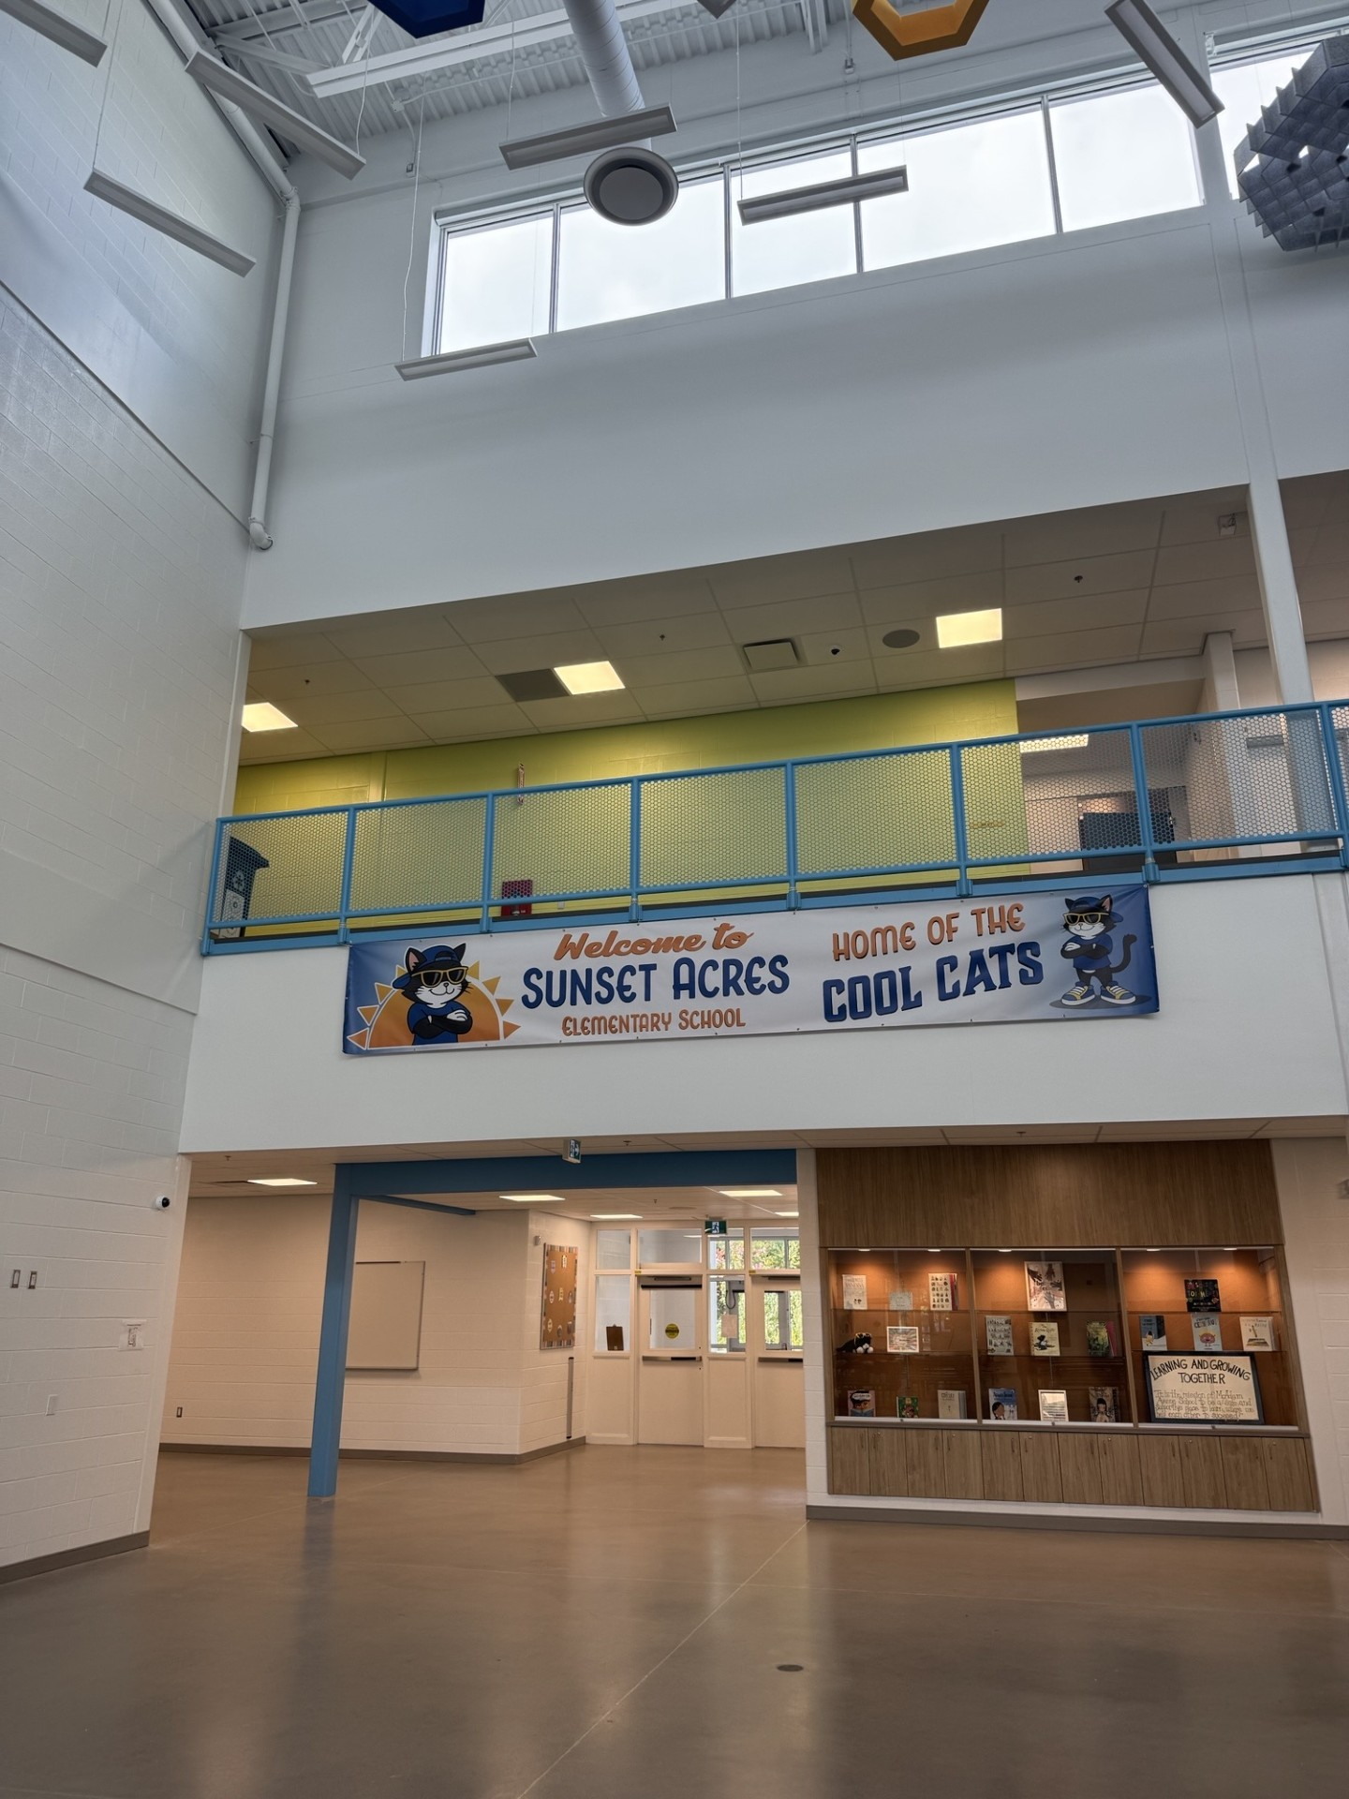
A Peek
Inside…

Slide 15
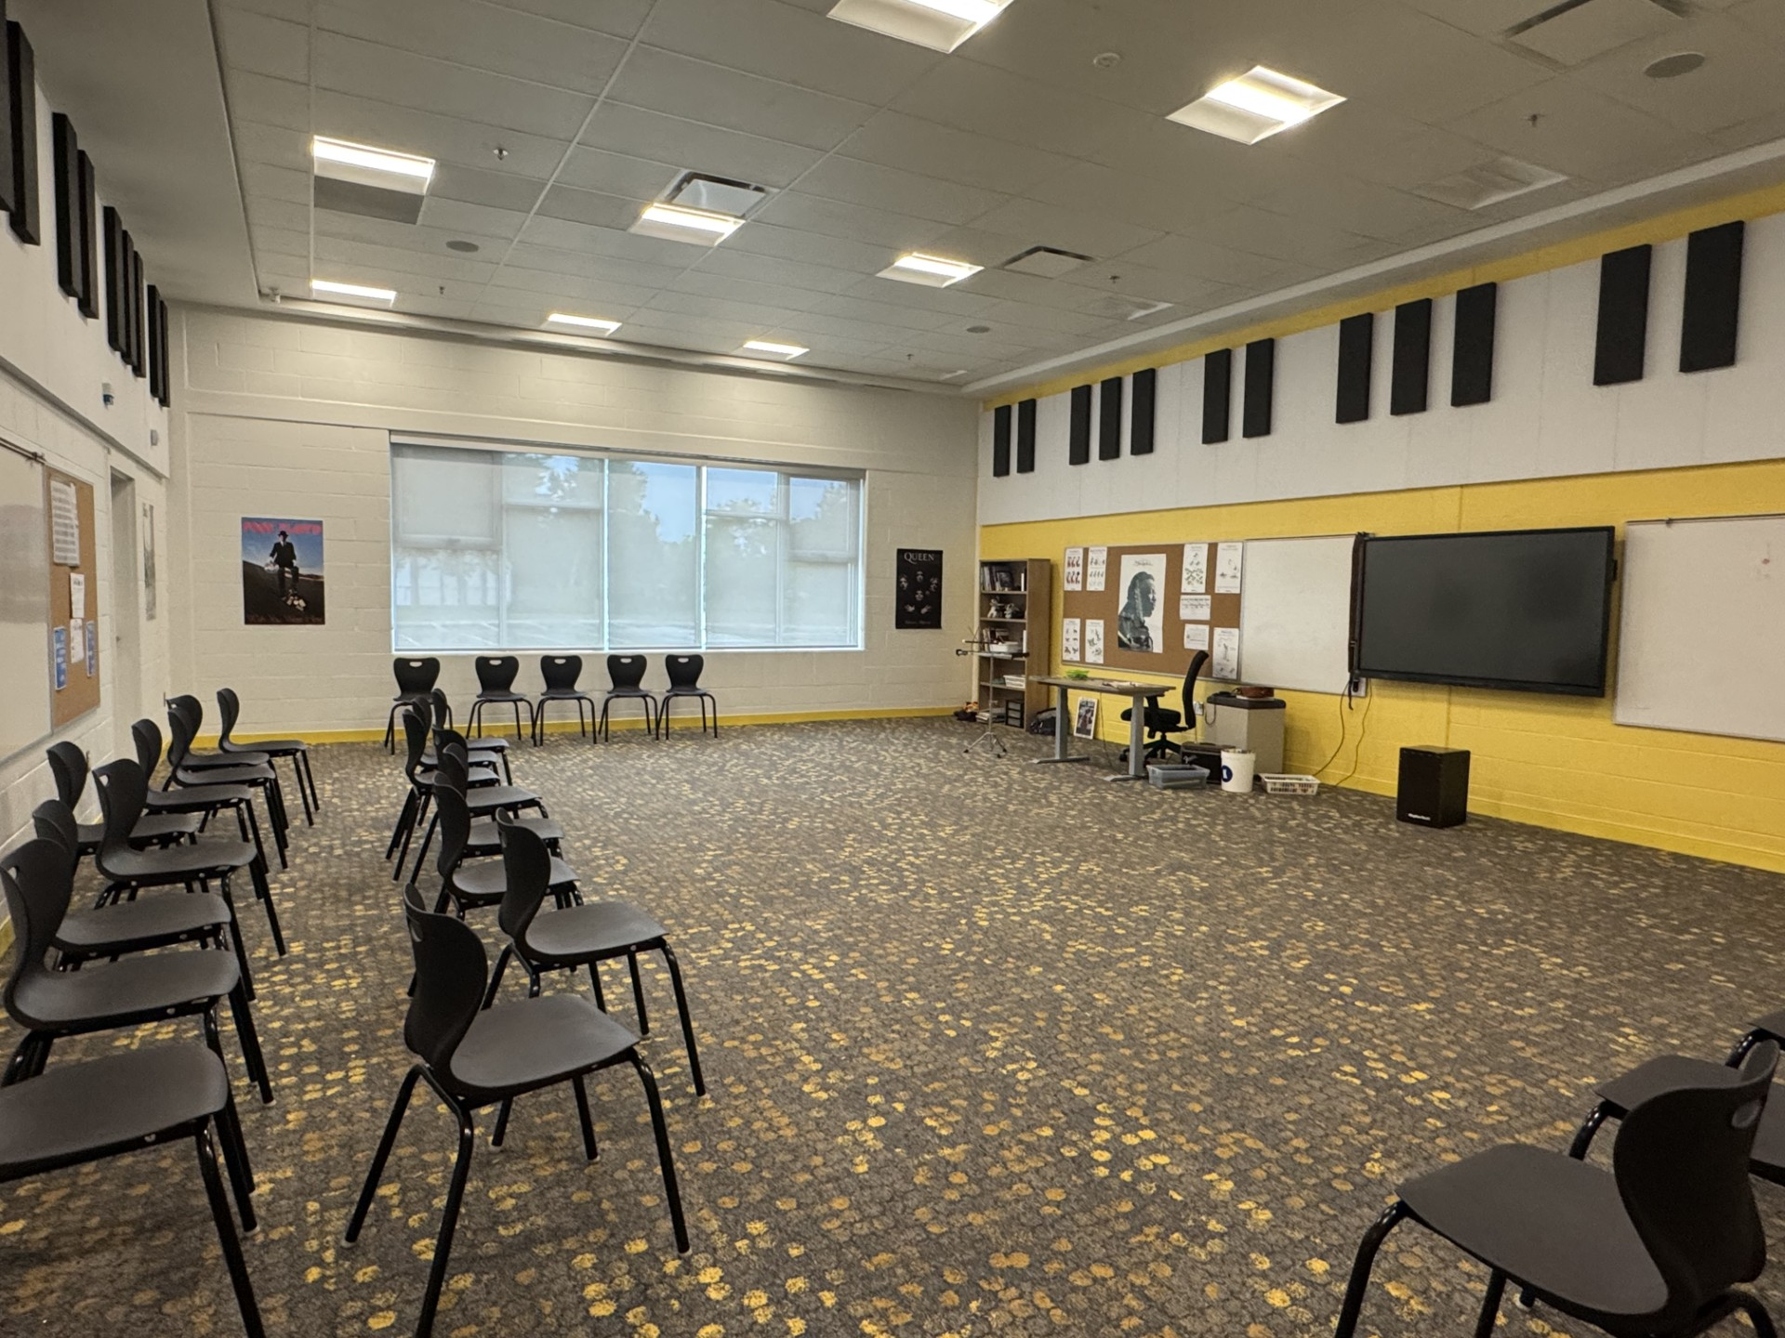
A Peek
Inside…

Slide 16
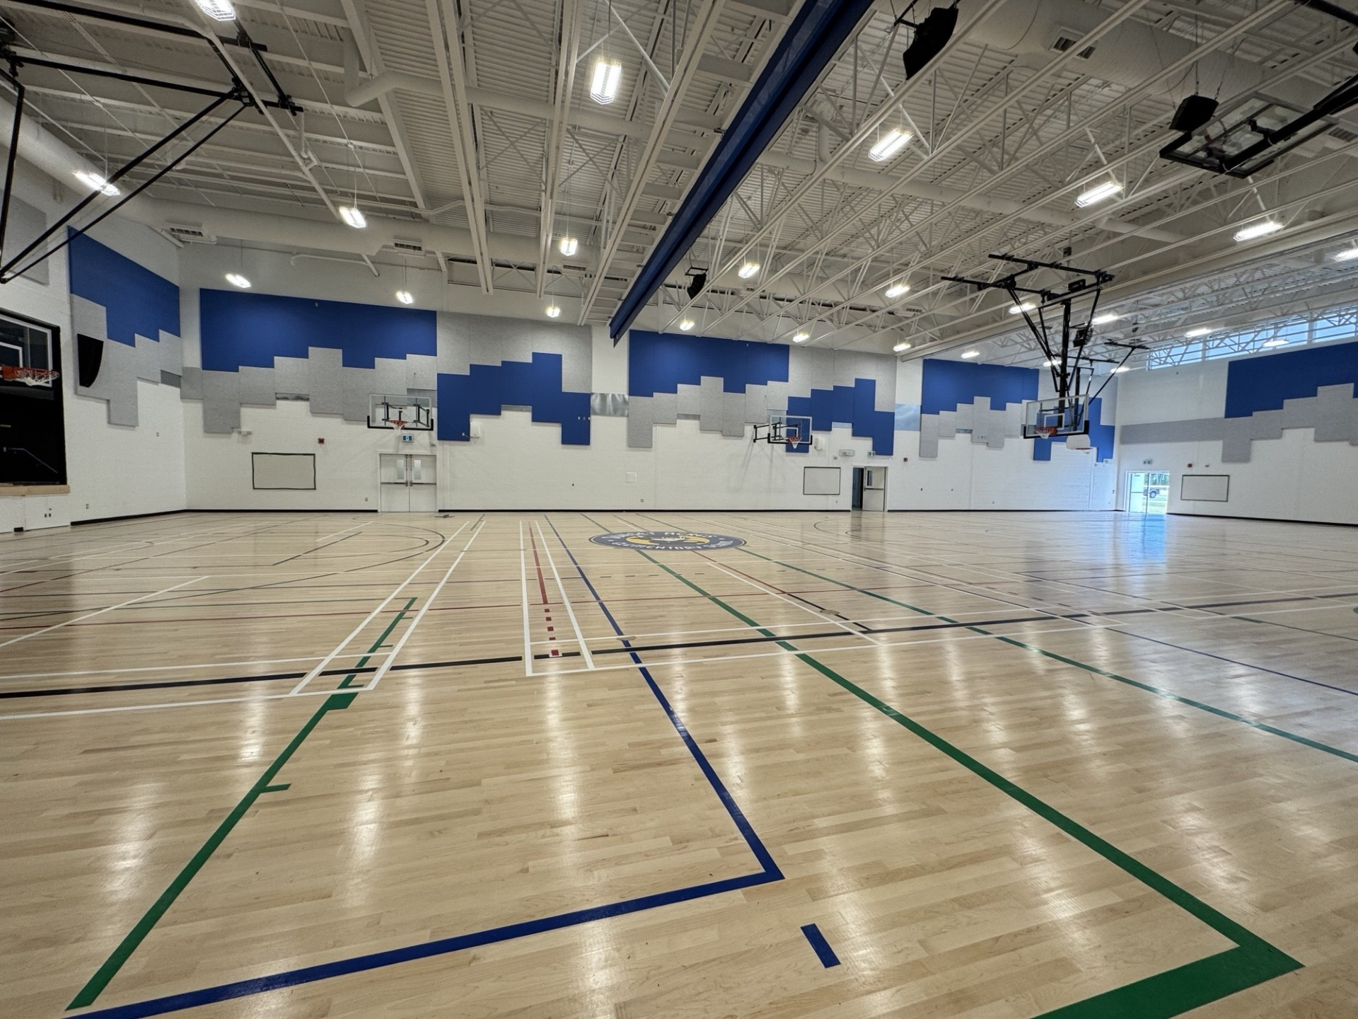
A Peek
Inside…

Slide 17
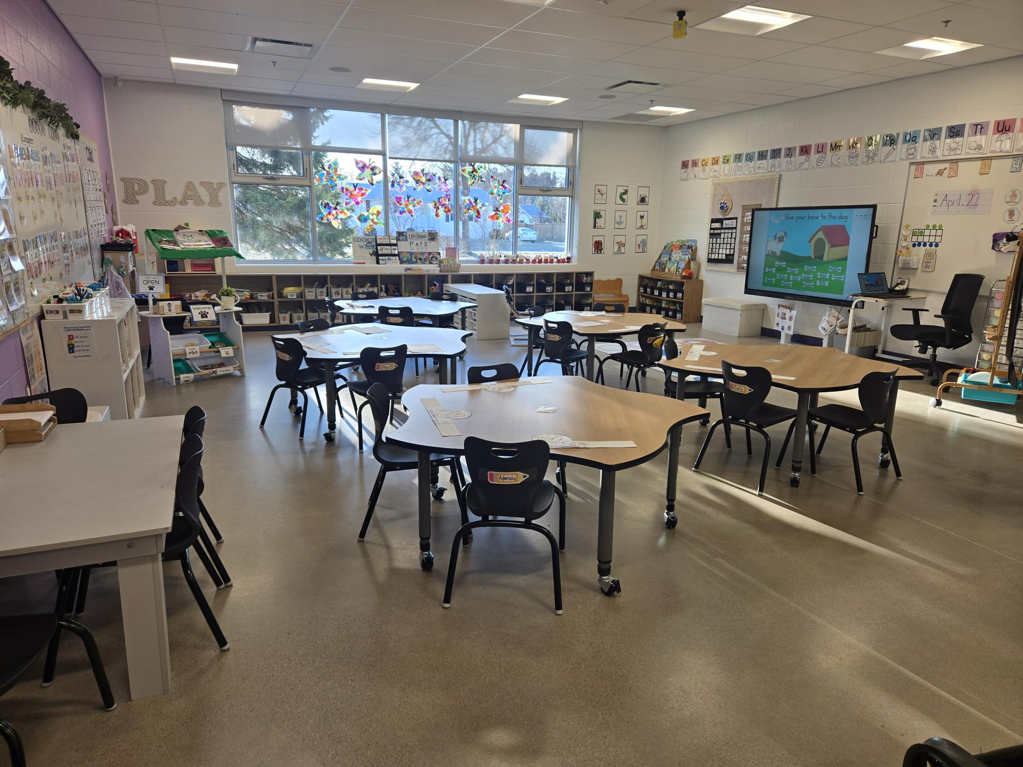
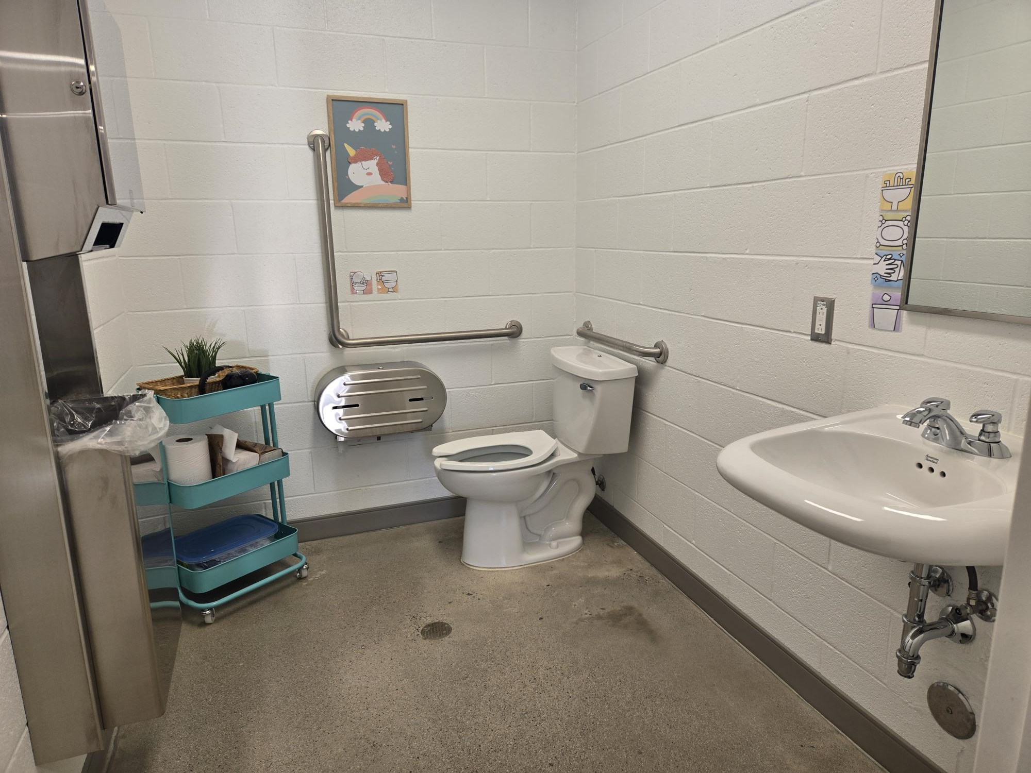
A Peek
Inside…

Slide 18
Want to Get Involved?
Home
&
School
PSSC
Other

Slide 19
Current Kindergarten Teachers
☺ Mrs. Katie Lyons (K)
☺ Mrs. Ann Murphy (K)
☺ Mrs. Lynsey Wall (K)

Slide 20
Current ESS Team
Lacey Clowater (Resource K-1)
Sandy Tucker (Resource 2-3)
Shawnna Stephens (Resource 4-5)
Erica Fournier (School Counsellor)
Amy Ferguson (School Social Worker)
Trishelle Palmer (Behaviour Intervention Mentor)
Laura Murdoch (Behaviour Intervention Mentor)
Sonya House (Academic Support Teacher)
Denise Bullock (English as an Additional Language)

Slide 21
Support Staff
5 custodians
2 Admin Assistants
30 Educational Assistants
1 Library Worker

Slide 22

Get Ready for Kindergarten!
Self-Help Skills
☺ Opening and closing containers/baggies
Putting on/taking off footwear
☺ Zipping and unzipping coat/bookbag
Packing and unpacking bookbag
Using the washroom

Slide 23
School Information for Next Year
Check our school website often for updates.
Check your emails regularly for updates.
Busing information is on the Anglophone West webpage. Just search “Anglophone West taking the bus”.
Your child will receive a handout at the beginning of the year with specifics about school routines and expectations.

Slide 24
Questions/Concerns Next Year
If you have questions or concerns next year, please contact your child’s teacher through email. If you have time sensitive information, call the main office. Staff have very little time to check email during the school day.
If you have a concern and are unable to resolve it with the teacher first, please reach out to myself or our Vice Principal. Please remember that all classroom and academic concerns must be discussed with the teacher first.

Slide 25
Kindergarten Orientation Pick-Up
After this presentation:
Children will be taking a ride on the bus and will be exiting the bus out back by the bus doors. Please wait on the sidewalk. Students will be released to their adult one at a time as they exit the bus. Please do not crowd the bus door. Your child will come to you when directed by the adults on the bus. Please walk around the front of the school (McAdam Ave side) to get to the parking lot. The next group will be arriving and we want to avoid congestion at the front door.

Slide 26

QUESTIONS??
It will be a
great Year!

